Slide 1
Introduction to Red Hat Enterprise Linux & Command Line

Slide 2
Viewing the Contents of Text Files
cat- displays the contents of a file by dumping it to the screen
tac-This command will dump the contents of a file to the screen, but with the last line first and the first line last
tail-to display the last ten lines of a file.
head-to display the first ten lines of a file.

Slide 3
more-This command will open a plain-text file viewer. In the viewer, you can browse the file using the Page Down key, Page Up key, or spacebar.

Slide 4
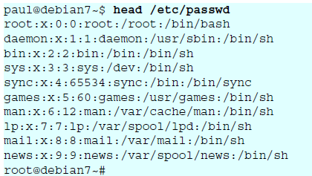
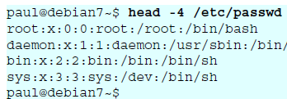


Slide 5



Slide 6
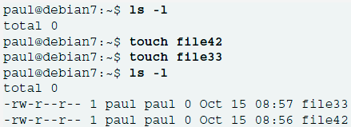
Creating Empty Files
One easy way to create an empty file is with touch command
It creates a zero-byte file

Slide 7
Piping and Redirection
piping is used to send the result of a command to another command
eg: ps aux | less
This command provides a list of all the processes that are currently running on your computer.
a = show processes for all users
u = display the process's user/owner
x = also show processes not attached to a terminal

Slide 8
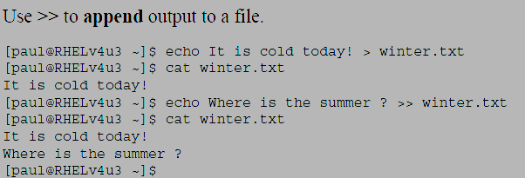
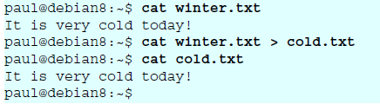
redirection sends the output of a command to a file.
This file can be a text file or a device file
eg : # ps aux > ~/psoutput.txt.
(i) Redirecting Output (STDOUT) to a File

Slide 9
(ii) Using Redirection of STDIN
If the email message is in a file then we can use it directly to send the mail.
eg : $ mail –s “Hello world” root < ~/mailcontent.txt
(iii) Separating STDERR from STDOUT
eg : $ find / -name root > errors.txt
As normal users cannot search root file system, errors will be generated and fed to find_errors.txt

Slide 10
(iv) Redirecting Output to device files
Important device files that can be used are:
1. /dev/null - The null device. Use this device to redirect to nothing.
2. /dev/zero - A device that can be used to generate zeros. This can be useful when creating large empty files.
3. /dev/ttyS0 -The first serial port
4./dev/tty1 - The name of the first text-based console that is active on your computer. These ttys are available from tty1 up to tty12.
5. /dev/sda -The first SCSI, SAS, serial ATA, or USB disk device in your computer.
6. /dev/sdb -The second SCSI or serial ATA device in your computer
eg : #cat /etc/passwd > /dev/tty12
• This will move output of passwd file to tty12.

Slide 11
(v)Cloning Devices Using Output Redirection
We can redirect contents of a storage device by using redirection.
• For example: We can clone sda disk to sdb by using
# cat /dev/sda > /dev/sdb
Redirecting to devices, can be very dangerous.
Eg : cat /etc/passwd > /dev/sda
A more efficient way to clone devices is to use the dd command. The advantage of using dd is that it handles I/O in a much more efficient way.
• To clone a device using dd, use
# dd if=/dev/sda of=/dev/sdb

Slide 12
find command
This command can find files based on any property the file may have.
• We can use find to search for files based on any file property, such as
their names;
the access, creation, or modification date;
the user who created them;
the permissions set on the file; etc.

Slide 13
find command
eg : To locate all files created by user linda
#find / -user "linda"
eg :Find any file less than 3 days old.
# find / -mtime -3
eg : Find .txt file less than 3 days old.
# find . –name “*.txt”-mtime -3
(. (DOT) – current working directory)
eg Find file having size larger than 10000k
# find . size +10000k
https://forms.gle/qRy1a2gRB8CENFHZ7

Slide 14
Performing Daily System Administration Tasks

Slide 15
Performing Job Management Tasks
Normally, commands takes brief moment to complete but sometimes commands take a few minutes to complete.
it is good practice to start them as a background job by putting an & sign at the end of the command.
eg: # makewhatis &
makewhatis command that is going to update the database used by the man -k command
The shell provides a job number and a unique process identification number (the PID) for this background job. You can then use these numbers to manage background jobs .

Slide 16
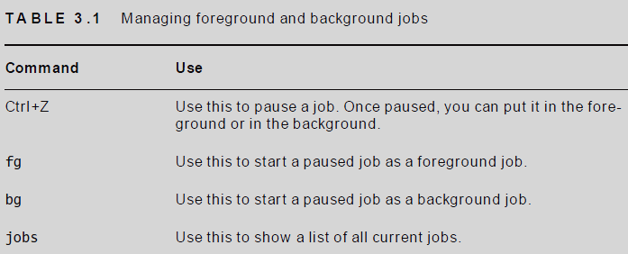
foreground and background jobs

Slide 17
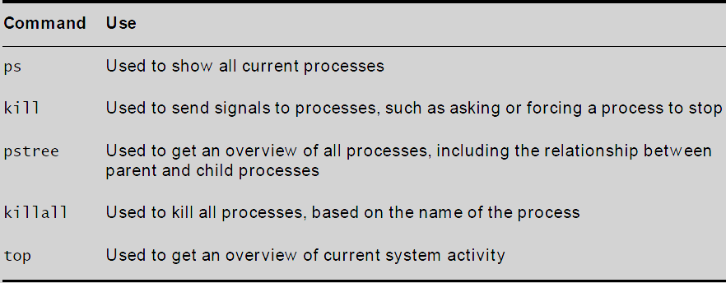
Commands for process management

Slide 18
Managing processes with ps command
ps command is used to find out what a specific process is doing on server.
Two useful ways to use the ps commands are
# ps afx - returns a treelike overview of all current processes
# ps aux - returns usage information for every process

Slide 19
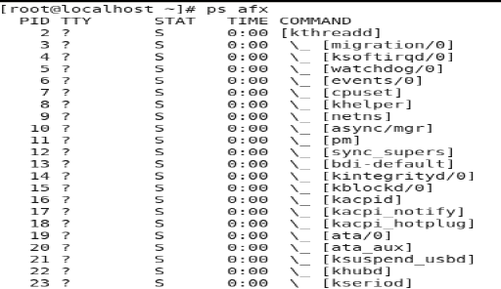

Slide 20
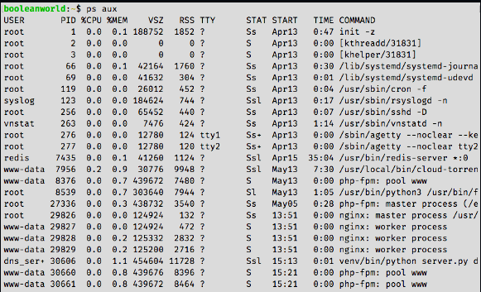

Slide 21
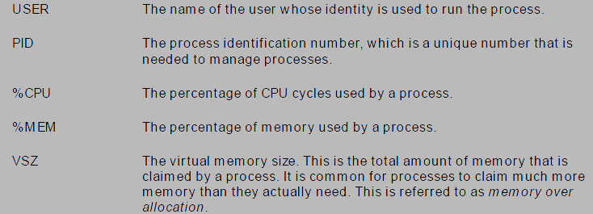

Slide 22
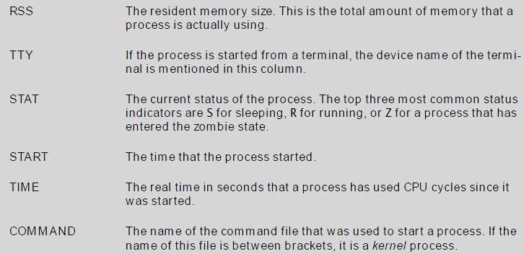

Slide 23
Managing processes with ps command
ps command is used to find out what a specific process is doing on server.
Two useful ways to use the ps commands are
# ps afx - returns a treelike overview of all current processes
# ps aux - returns usage information for every process

Slide 24
Sending Signals to Processes with the kill Command
In ps afx, f option shows the relationship between parent and child processes. To kill a process, we need to know parent process
To send signals to processes, you use the kill command
First argument is the number of the signal you want to send to the process
• Second argument is the PID of the process to which you want to send a signal.
Example: # kill -9 1234
will send the SIGKILL signal to the process with PID 1234.

Slide 25
Three signals are available in linux:
SIGHUP (1), SIGKILL (9), and SIGTERM (15).
1.SIGTERM - is used to ask a process to stop its activity, the process close all open files and stop using its resources.
2. SIGKILL -doesn’t allow the process any time at all to stop its activity; that is, the process is simply cut off, hence there is risk of damaging open files.
Example: # kill -9 123 or kill -SIGKILL 123
• The above command sends the SIGKILL signal to the process with PID 123.
3. SIGHUP -signal tells a process that it should reinitialize and read its configuration files again

Slide 26
killall Command:
To send specific signals to multiple processes simultaneously use killall command ,which takes the name of a process as its argument.
• For example: # killall -SIGTERM httpd
command sends the SIGTERM signal to all active httpd processes

Slide 27
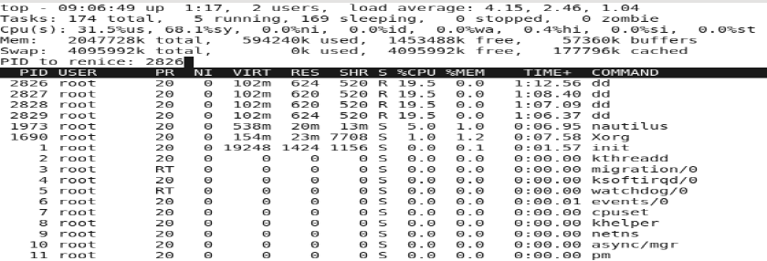
Using top to Show Current System Activity
The top program offers a convenient interface in which you can monitor current process activity and also perform some basic management tasks

Slide 28
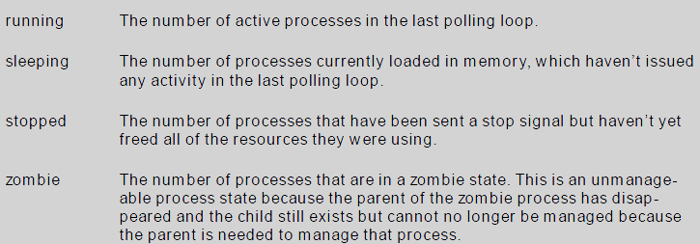

Slide 29
CPU states
us The percentage of time your system is spending in user space,
sy The percentage of time your system is working on kernel-related
tasks in system space.
ni The amount of time your system has worked on handling tasks of
which the nice value has been changed
id The amount of time the CPU has been idle.
wa The amount of time the CPU has been waiting for I/O requests.
hi The amount of time the CPU has been handling hardware interrupts
si The amount of time the CPU has been handling software interrupts.
st The amount of time that has been stolen from this CPU

Slide 30
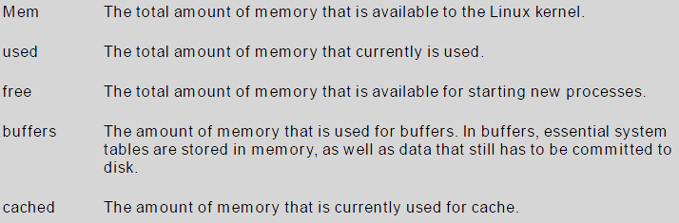
The following parameters show how memory is used currently

Slide 31
Managing Process Niceness
Every process being executed starts with the same priority ,To change the priority of a process nice command is used
you can adjust the process niceness from -20, which is good for the most favorable scheduling, to 19 for the least favorable scheduling
By default, all processes are started with a niceness of 0.
eg: # nice -n -10 dd if=/dev/sda of=/dev/sdb
you can also use the renice command to adjust the niceness of a command that has already started
you want to adjust the niceness of the find command, then get PID using following command.
# ps aux | grep find
Assuming the PID is 1234, you can use
eg : # renice -10 1234

Slide 32
Scheduling Jobs
To start jobs automatically, use cron.
cron consists of two parts.
First there is the cron daemon, a process that starts automatically when your server boots.
The second part is the cron configuration. This is a set of different configuration files that tell cron what to do.
cron jobs are started from the directories
/etc/cron.hourly
/etc/cron.daily,
/etc/cron.weekly,
/etc/cron.monthly.

Slide 33
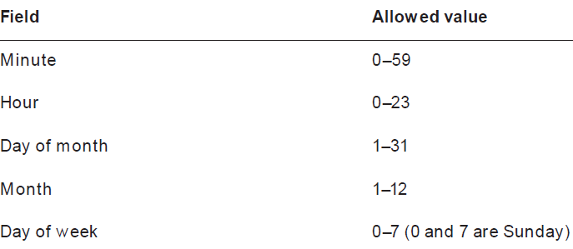
In a crontab specification, the time indicator 0 2 3 4 *
This indicates that a cron job will start on minute 0 of hour 2 (which is 2 a.m.) on the third day of the fourth month. Day of week is not specified, which means the job would run on any day of the week.

Slide 34
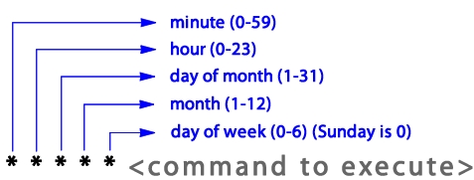
Example:
In a cron job definition, we can use ranges as well.
*/5 * * * *
/5 means that a job has to run every five minutes
• list of comma-separated values, like
0 14,18 * * *,
to run a job at 2 p.m. and at 6 p.m.
Dash can be used to specify a range.
0 5-10 * * *
This will run once every hour between 5:00am and 10:00am:
Refer : https://crontab.guru/

Slide 35
Mounting Devices
As an administrator, you need to make storage devices like USB flash drives, hard drives, or network shares available.
To do this, you need to connect the device to a directory in the root file system. This process is known as mounting the device
To mount a storage device
(i)name of the device you want to mount
(ii) which directory do you want to mount it

Slide 36
lsscsi command to find out the current configuration for your server
blkid provides an overview of all block devices currently connected to your computer.
The last few lines of dmesg show the names of devices that were recently connected to your computer.
After finding the device name of your USB drive, you also need to find out whether there are any partitions on the device.
use fdisk -cul dev/sdb to see the current partitioning of the USB drive

Slide 37
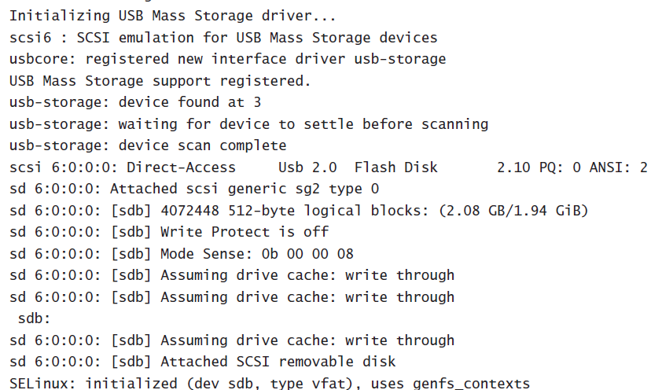
dmesg shows the name of recently connected block devices

Slide 38
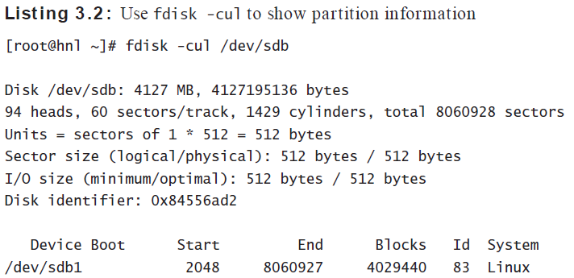
fdisk -cul to show partition information

Slide 39

To mount the device /dev/sdb1 on the directory /mnt, you would use the following command:
mount /dev/sdb1 /mnt
To unmount a device that currently is mounted on /mnt, use
umount /mnt

Slide 40
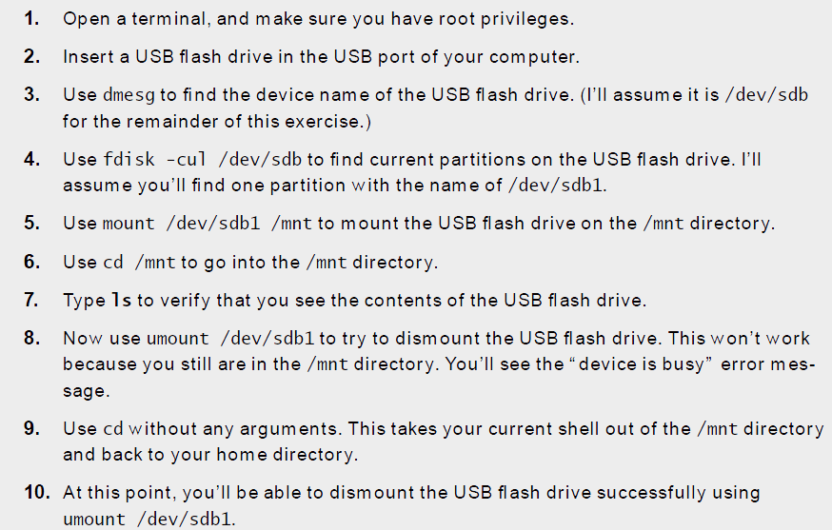
Mounting a USB Flash Drive

Slide 41
Working with Links
In a Linux file system, we can access a single file from different locations using links.
• Because of this we need not copy files to different locations and make versions.
• A link looks like a regular file, but it’s more like a pointer that exists in one location to show you how to get to another location.
• In Linux, there are two different types of links.
Symbolic link
Hard link.

